Slide 1



Graduate Portfolio Milestone Master of Science Applied Data Science
By
Thulasi Ram Ruppa Krishnan
SUID: 460746269
https://www.linkedin.com/in/thulasiram-ruppa-krishnan-8744a45b/
https://github.com/truppakr/applieddatascience
https://github.com/truppakr/applieddatascience/upload/master/portfolio

Slide 2

About me
I am currently working as a Senior Data Engineer @ Teladoc Health Inc
I completed my undergraduate in Bachelor of Engineering @ Thiagarajar College of Engineering, Madurai, India.
I have more than 13+ years of working experience in IT and have worked predominantly in the field of Data Engineering which includes but not limited to Application Development, Datawarehouse Development, Report and Dashboard Development, Architecting Database solutions and applying encryption on Enterprise information system
I have played a variety of roles as a Data Analyst, Developer , Lead and Architect.
I got inspired in the field of Data Science and joined M.S in Applied Data Science program offered by Syracuse University in 2019.

Slide 3

About the Program
Data science is an inter-disciplinary field that uses scientific methods, processes, algorithms and systems to extract knowledge and insights from many structured and unstructured data. Data science is related to data mining, deep learning and big data.
Data science is a "concept to unify statistics, data analysis, machine learning and their related methods" in order to "understand and analyze actual phenomena" with data. It uses techniques and theories drawn from many fields within the context of mathematics, statistics, computer science, and information science. Turing award winner Jim Gray imagined data science as a "fourth paradigm" of science (empirical, theoretical, computational and now data-driven) and asserted that "everything about science is changing because of the impact of information technology" and the data deluge

Slide 4
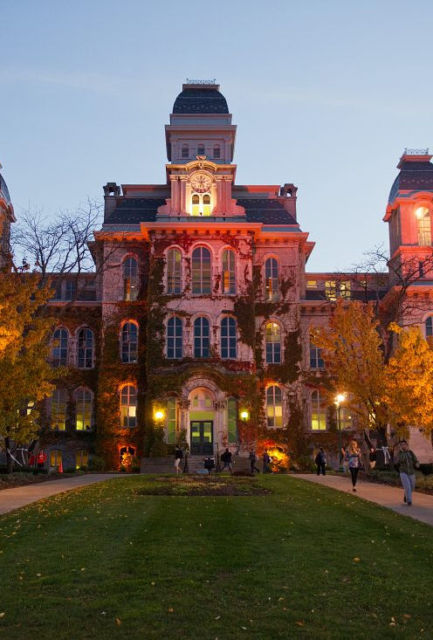
About Syracuse University
Syracuse University is a private research university of extraordinary academics, distinctive offerings and an undeniable spirit.
MS in Applied Data Science @ Syracuse University
Developed by the School of Information Studies in conjunction with the Martin J. Whitman School of Management, the MS in Applied Data Science program draws insights from both the field of information studies and the field of management to help students effectively apply analytical concepts to gain insight from data.

Slide 5
Learning Objective
Objective
Develop plan of Action and Business Decision
Communicate Results and Outcome
Overview Data Science Practices
Identify Patterns
Develop Strategies
Synthesis ethical dimension in Data Science
Collect and Organize Data
Notes:
The following are the learning objectives of the Syracuse Master of Applied Data Science Program.
Describe a broad overview of the major practice areas in data science.
Collect and organize data.
Identify patterns in data via visualization, statistical analysis, and data mining.
Develop alternative strategies based on the data.
Develop a plan of action to implement the business decisions derived from the analyses.
Demonstrate communication skills regarding data and its analysis for relevant professionals in their organization.
Synthesize the ethical dimensions of data science practice.

Slide 6

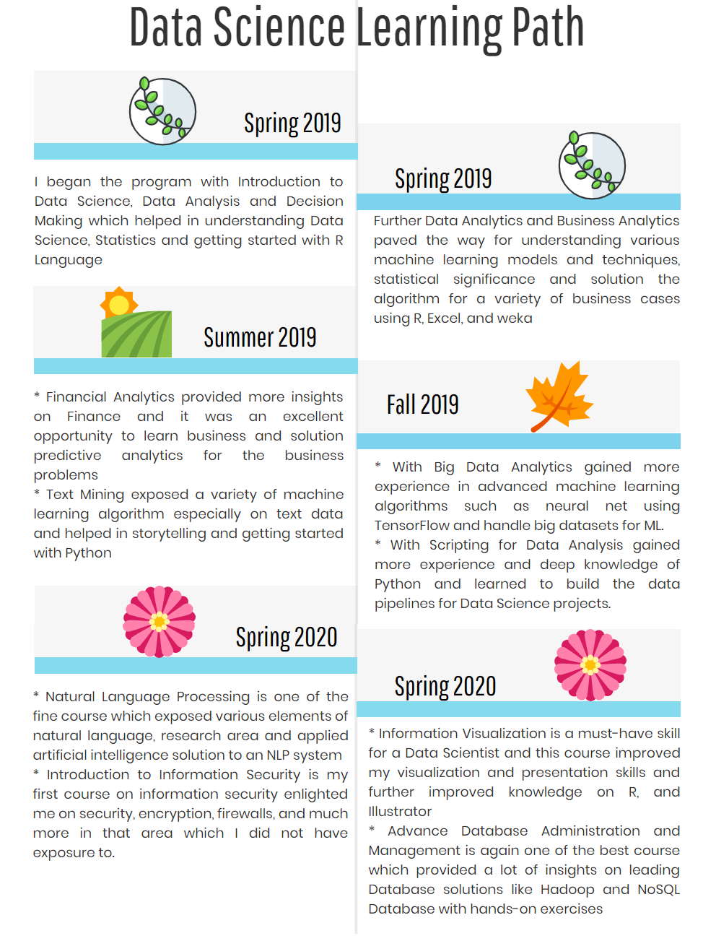



Learning Path

Slide 7




Course Completed
Dept. Prefix & No. | Course Title | Semester | Credit Hours | Grade | Instructor
IST 687 - M402 | Introduction to Data Science | Spring 2019 | 3 | A+ | John Santerre
MBC 638 - M400 | Data Analysis and Decision Making | Spring 2019 | 3 | A- | Kimberly Pendelberry
IST 707 - M405 | Data Analytics | Spring 2019 | 3 | A+ | Ami Gates
SCM 651 - M426 | Business Analytics | Spring 2019 | 3 | A- | Raghavshyam Ramamurthy
FIN 654 - M401 | Financial Analytics | Summer 2019 | 3 | A+ | William Foote
IST 736 - M400 | Text Mining | Summer 2019 | 3 | A+ | Ami Gates
IST 718 - M402 | Big Data Analytics | Fall 2019 | 3 | A+ | Jillian Lando
IST 652 - M402 | Scripting for Data Analysis | Fall 2019 | 3 | A+ | Lefteris Anastasopoulos
IST 623 - M400 | Introduction to Information Security | Spring 2020 | 3 | A+ | Joon Park
IST 664 - M401 | Natural Language Processing | Spring 2020 | 3 | A+ | Michael Larche
IST 719 - M402 | Information Visualization | Spring 2020 | 3 | In Progress | Gary Krudys
IST 769 - M401 | Advanced Database Administration Concepts and Database Management | Spring 2020 | 3 | In Progress | Gregory Block

Slide 8
Key Projects

Slide 9
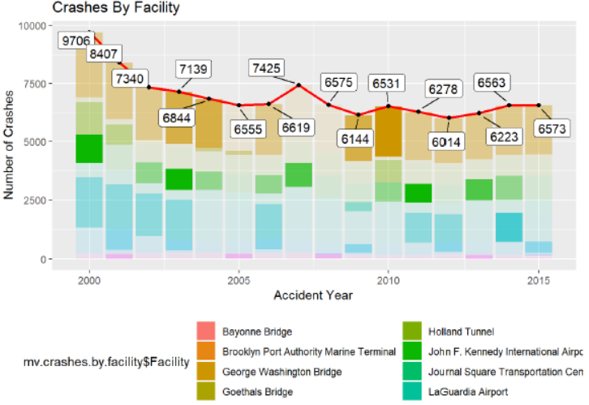
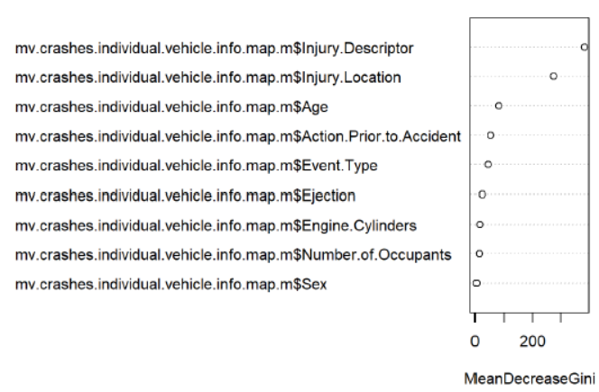
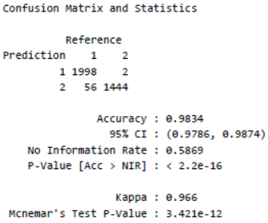
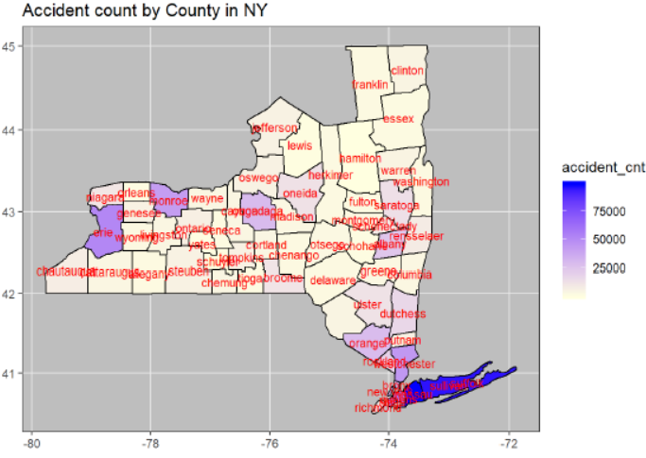
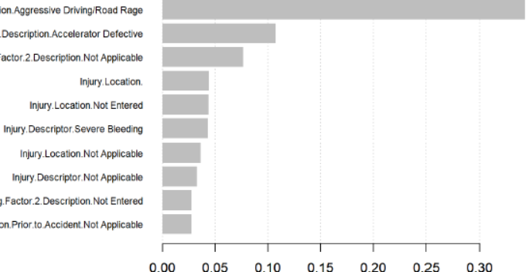
IST 687 - NYS-Motor-Vehicle-Crashes Fatal accident Prediction
Model Accuracy
---------------------------------------------
XG Boost → 98.34%
Importance Matrix
Source : Kaggle
Professor :John Santerre
By
Thulasi Ram Ruppa Krishnan
Lissy Krainin
Patricia Fiorillo
Breeana Baker

Slide 10
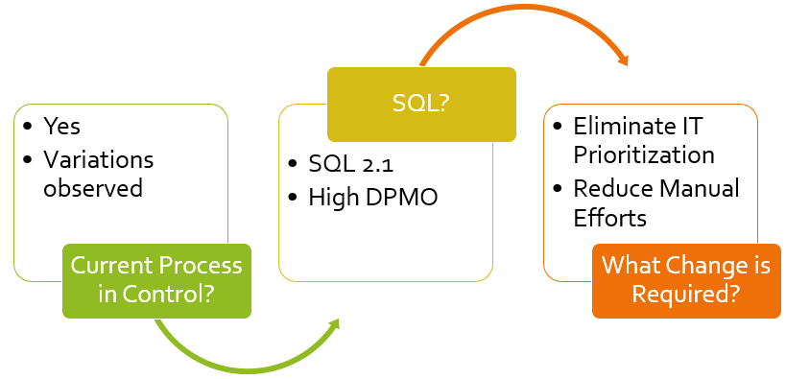
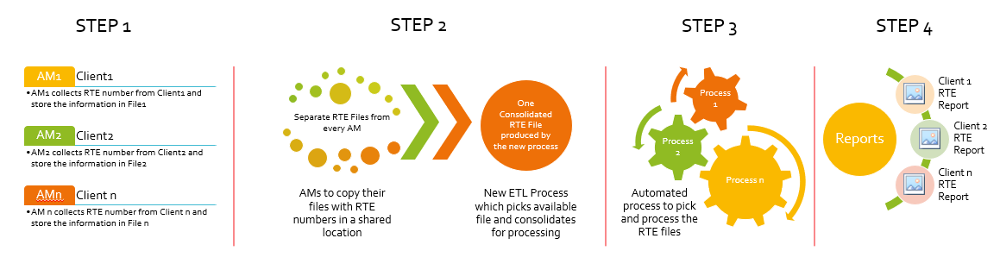
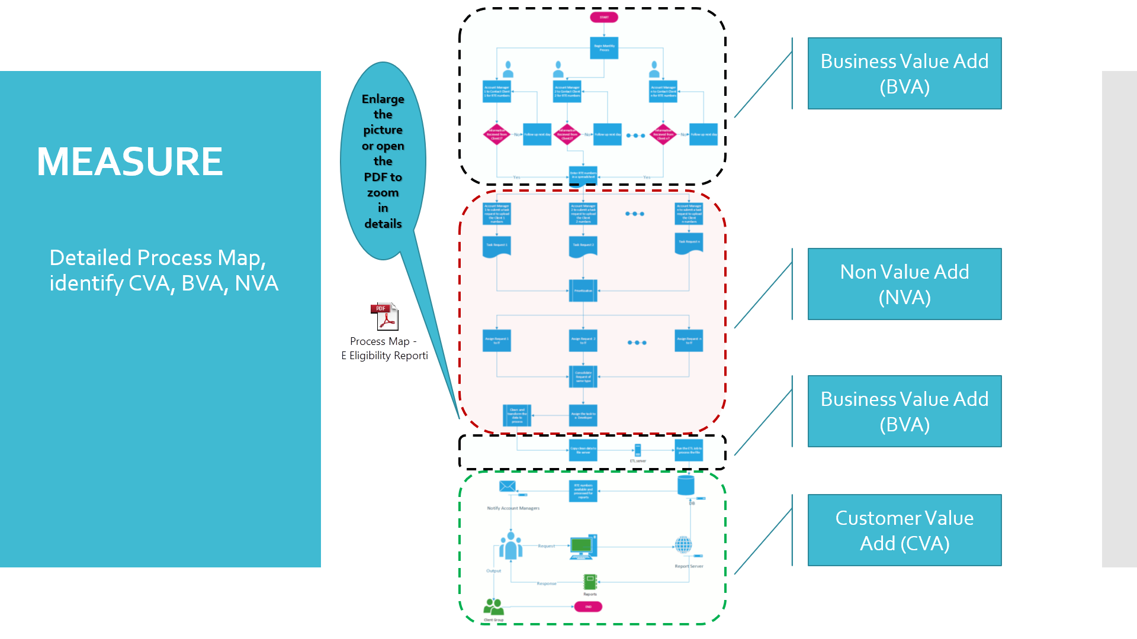
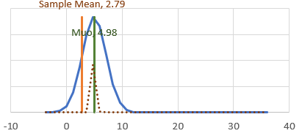
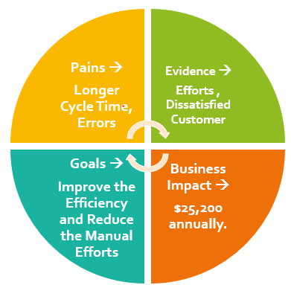
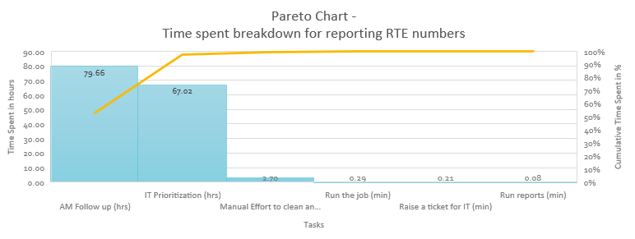
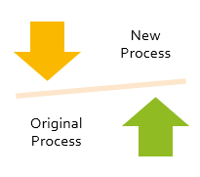
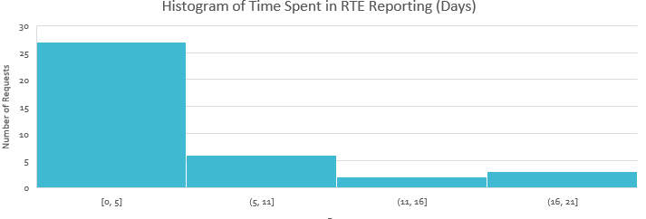
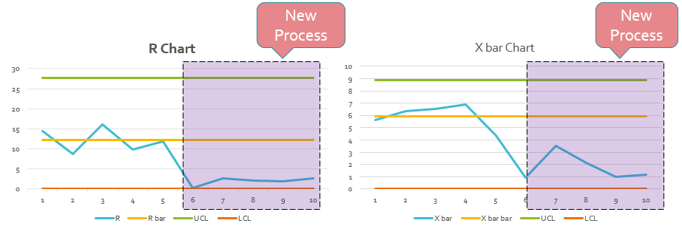
MBC 638- Reduce Cycle Time to Report RTE Numbers
DEFINE
Problem Statement
MEASURE
Process Map is derived Identified CVA, BVA, NVA
Efforts are Measured
ANALYZE
CONTROL IMPROVE
Today, my company is receiving eligibility numbers from RTE clients through account managers every month. Account managers will then enter these numbers in a common spreadsheet located in a SharePoint. This spreadsheet is then downloaded, formatted and uploaded in EDW for Reporting by IT. The manual steps involved in downloading, formatting and uploading the numbers to EDW which is time consuming, error prone and more effort intensive operation.
Implemented a Solution and the new process flow is measured
SQL is improved from 2.1 to 2.8
Control Charts are in place to
stay alert
Descriptive Statistics and Histogram derived
Professor :Kimberly Pendelberry By Thulasi Ram Ruppa Krishnan

Slide 11
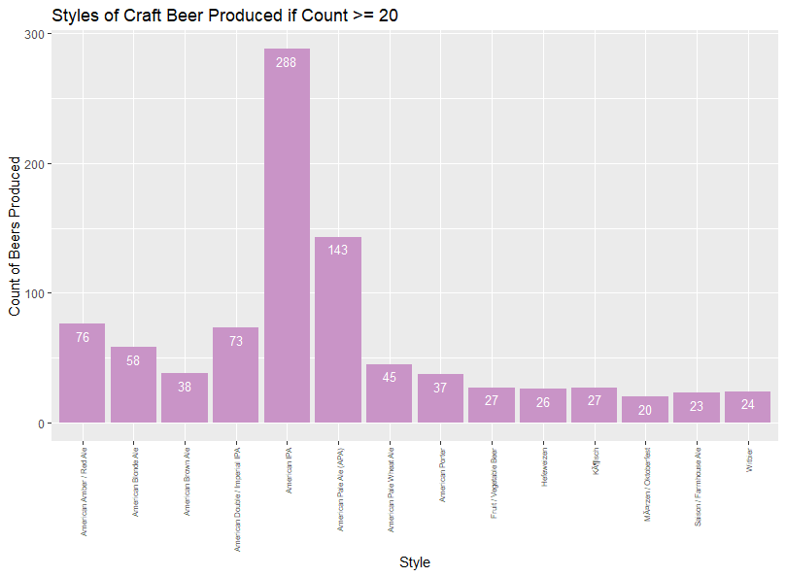
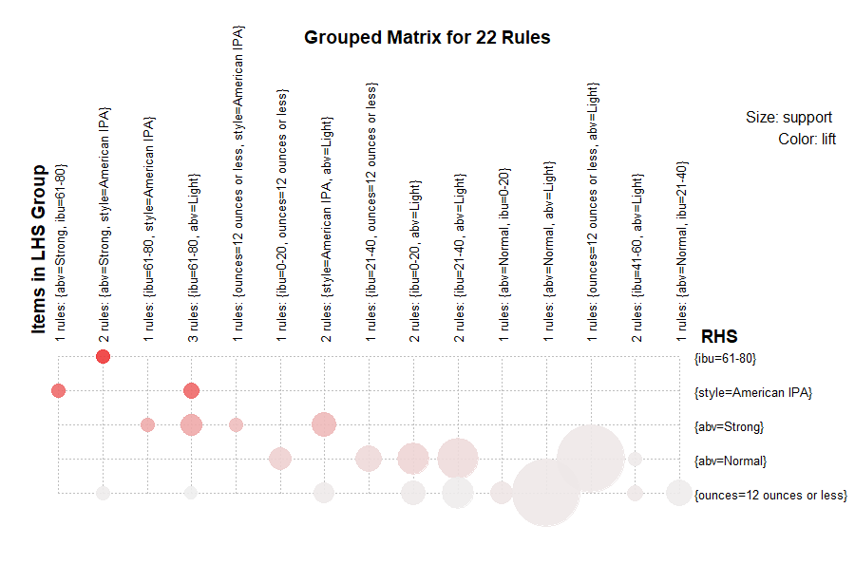
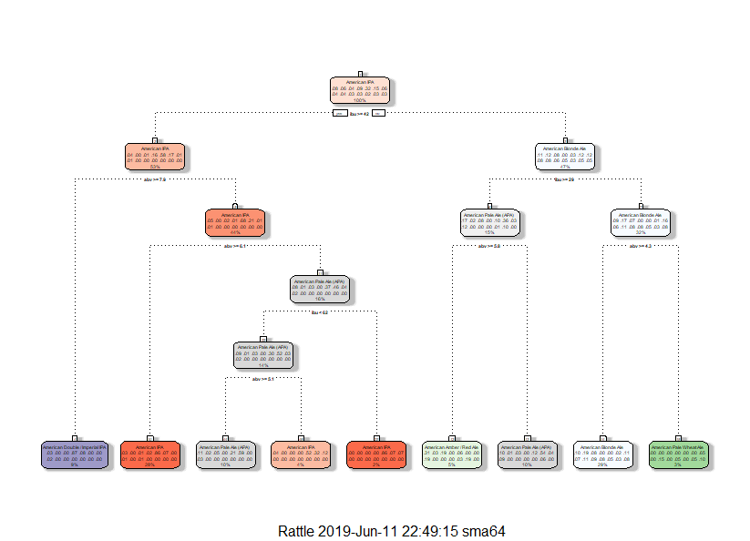
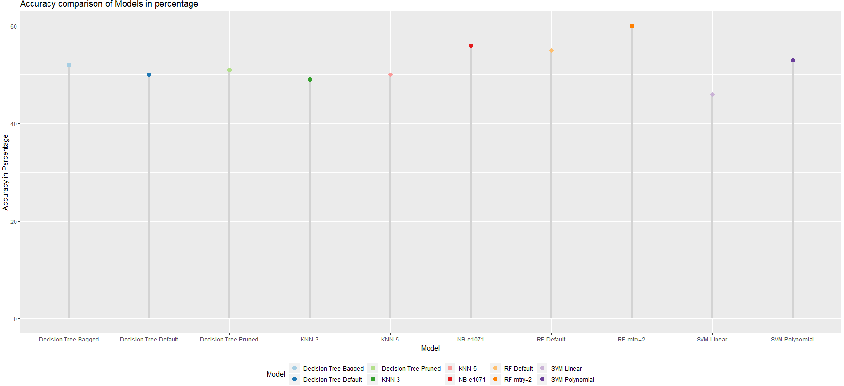
IST 707 - Craft Beer style prediction and Brewery Analysis
Model Accuracy
---------------------------------------------
Naïve Bayes → 56.11%
SVM → 53.4%
KNN → 50.83%
Random Forest → 56.44%
Source : Kaggle
Professor :John Santerre
By
Thulasi Ram Ruppa Krishnan
Samantha McNeilly

Slide 12
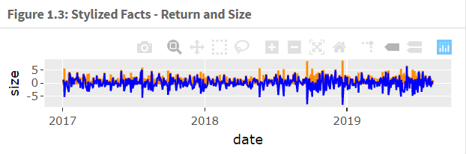
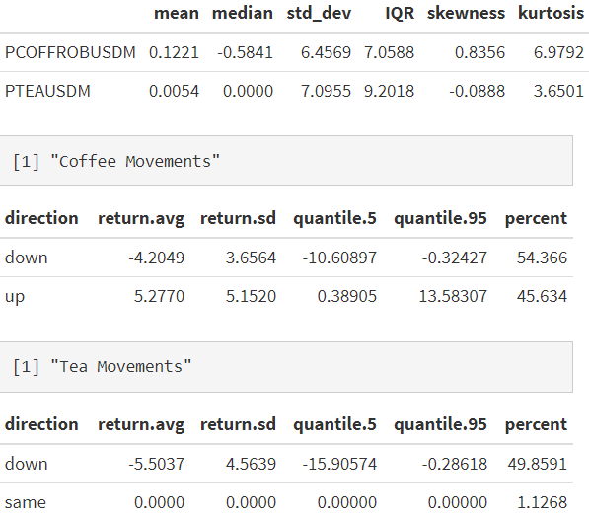
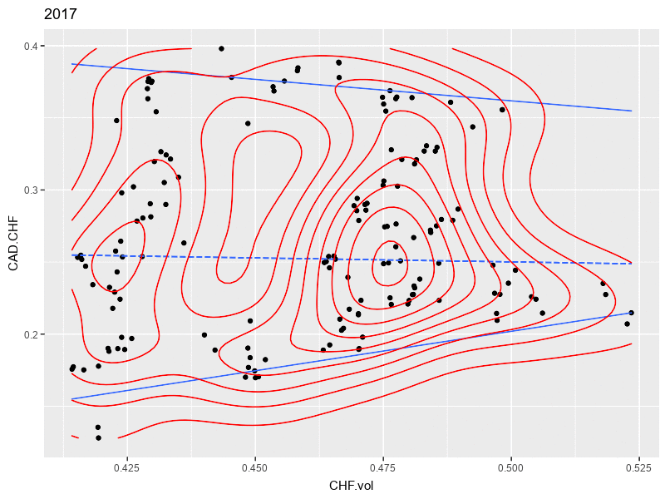
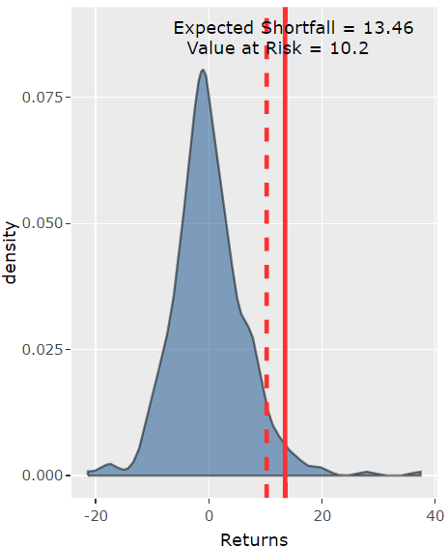
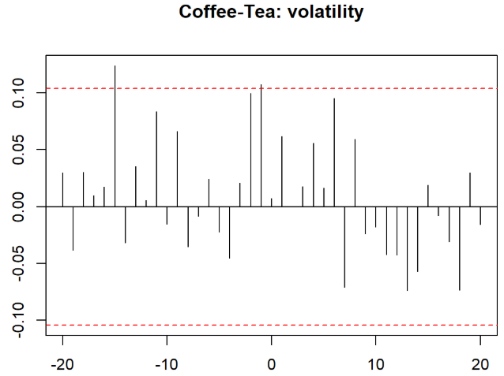
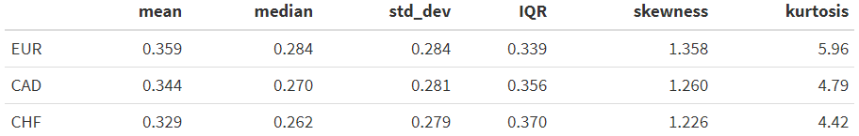
FIN654 - Financial Analytics on Coffee business
Source : Bloomberg
Professor : William Foote
By
Thulasi Ram Ruppa Krishnan
Hongseok Kim

Slide 13
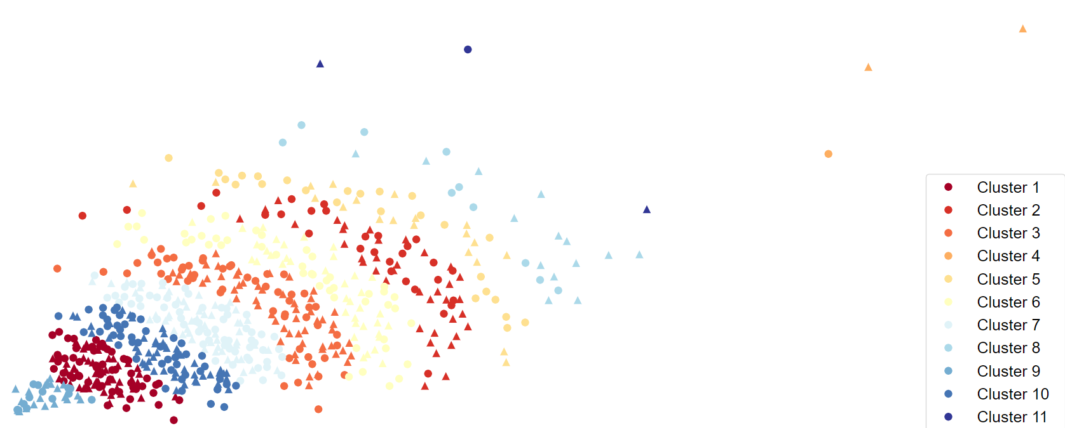
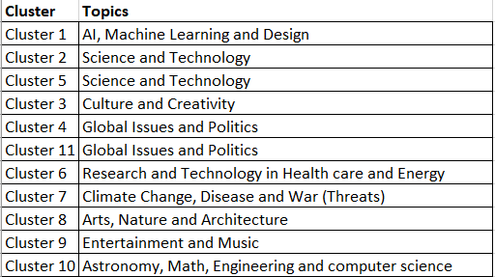
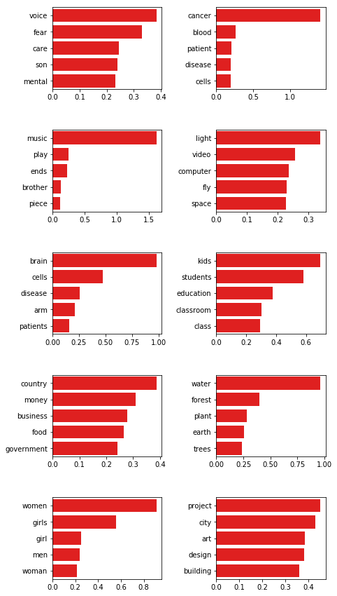
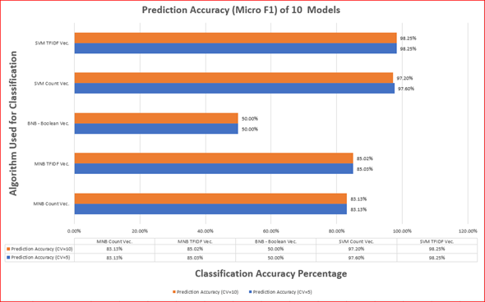
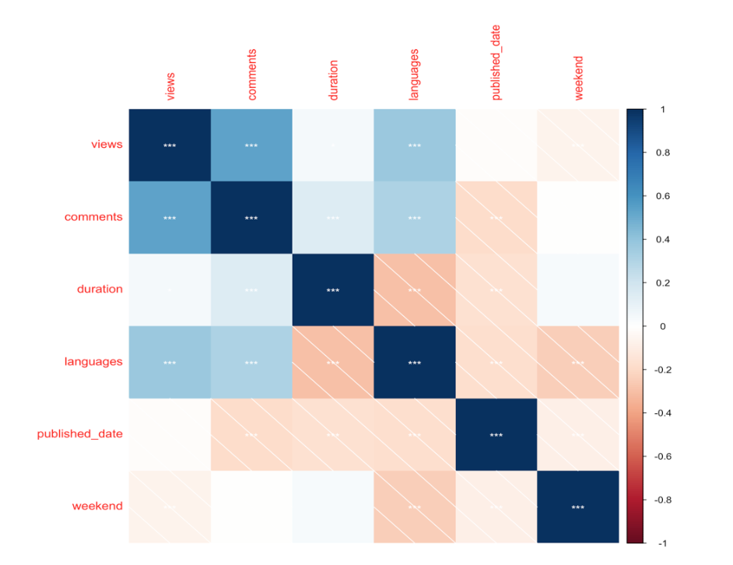
IST 736 - Text Mining on TED Talks and Popularity Prediction
Source : Kaggle Professor :Ami Gates
By Thulasi Ram Ruppa Krishnan, Jean Deleon, Kelly Schillacci, Sulav Rupakhaeti
Topic Distribution
Clustering
Correlation Matrix

Slide 14
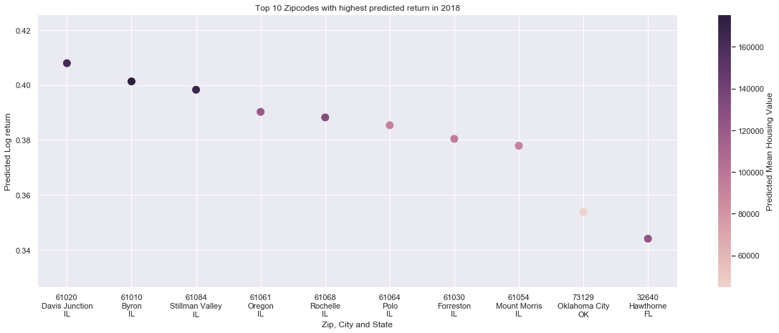
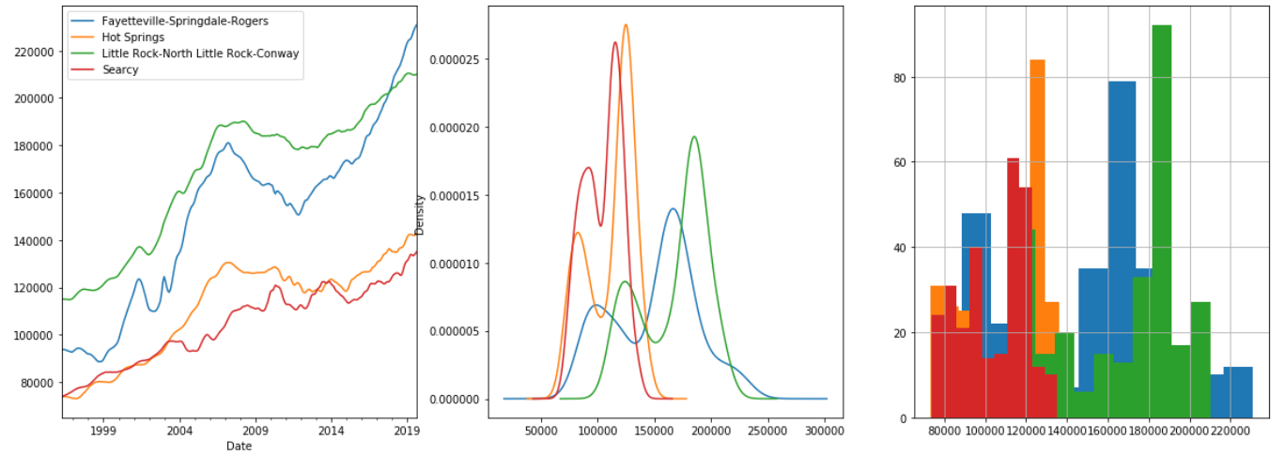
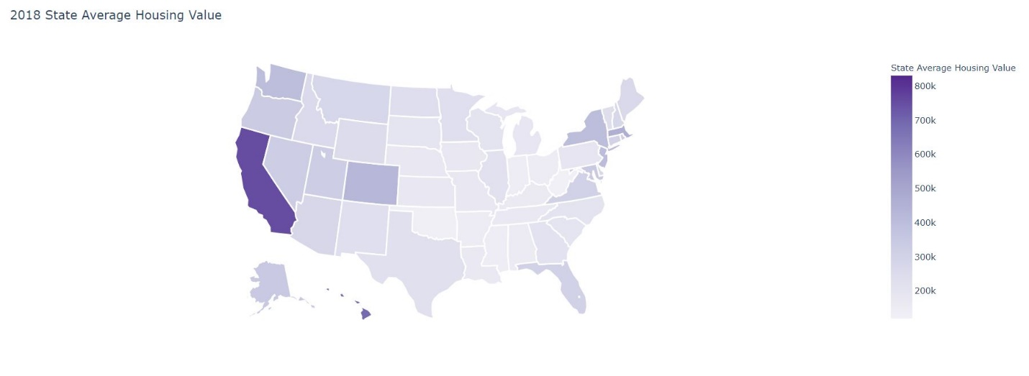
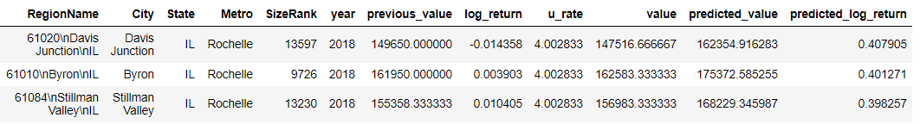
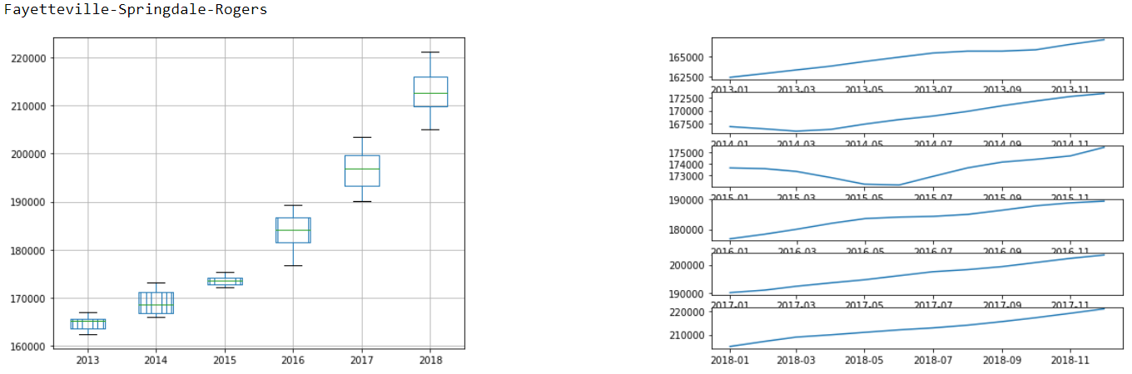
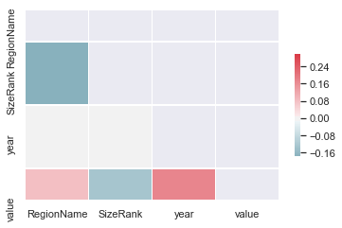
IST 652 - Zillow home value Prediction
Source : Kaggle
Professor :Jason Anastasopoulos
By Thulasi Ram Ruppa Krishnan
Model Accuracy
---------------------------------------------
OLS Regression → 98%

Slide 15
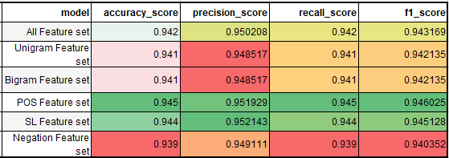
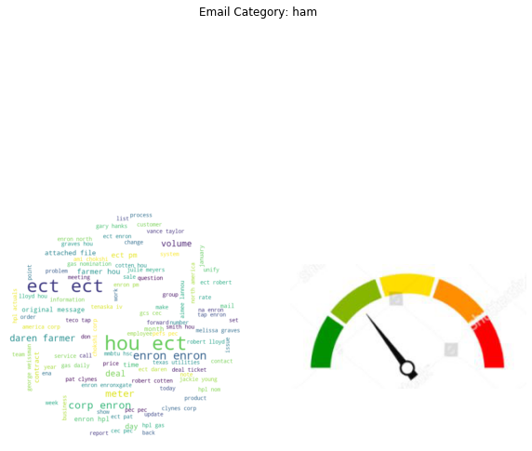
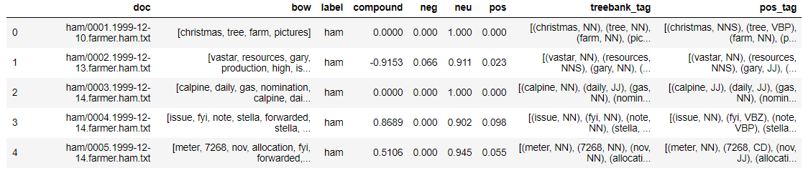
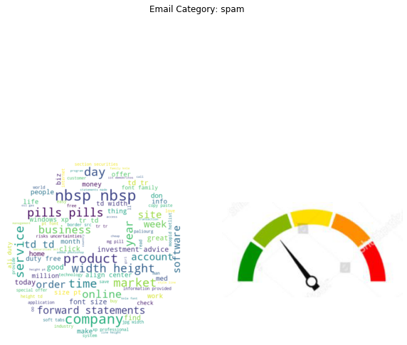
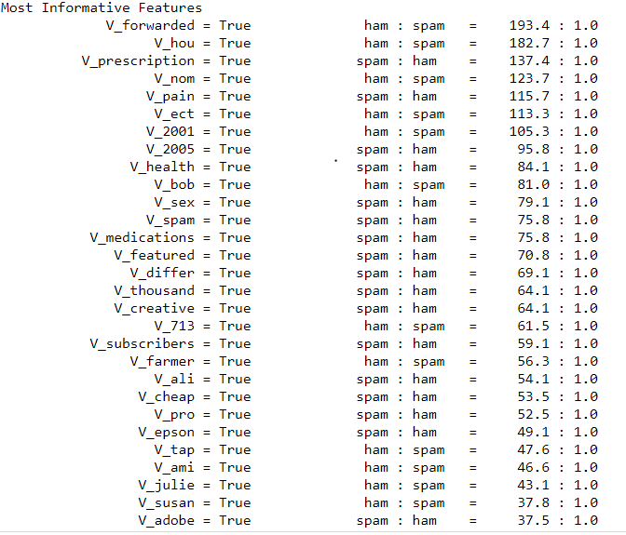
IST-664 Classification of Email Spam Corpora using NLP
Source : Enron public email corpus
Professor : Michael Larche
By Thulasi Ram Ruppa Krishnan
HAM
pos
neg
SPAM
pos
neg

Slide 16
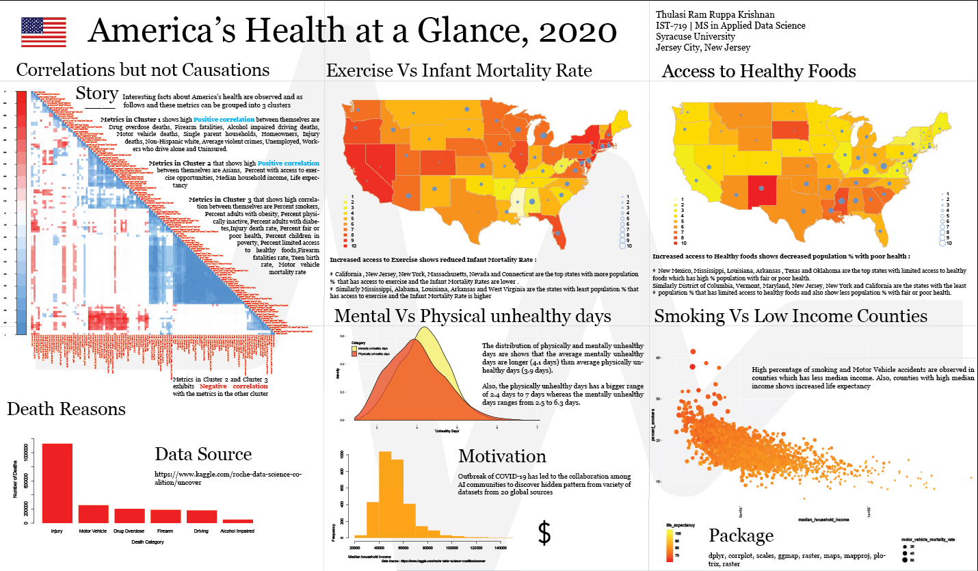
IST 719 - Information Visualization
The aim of this project is to convey the story visually using USA health data

Slide 17
Accomplishments
Highlights
Machine Learning
Statistics, Math and NLP
Big Data
Supervised Learning
Classification
Central Limit Theorem, Correlation and Causation
Normal and Skewed Distribution
Semi structured/Unstructured Data
Unsupervised Learning
Clustering
Binomial, Poisson and T Distribution
Dimensionality Reduction
Null Hypothesis and Chi Square Test
Distance and Kappa Measures
Visualization
ggplot, matplotlib, plotly, D3
Bar/Pie/Point and Line chart
Geo Maps, Heat maps tree map and confusion matrix
Regression
Linear
Logistic
Naïve Bayes
SVM
K Means
PCA
Hadoop Ecosystem
Mongo DB
Cassandra
Redis
Kafka
Scatterplot, Bubble chart and Step chart
Hist , density curve, Box plot and violin plot
Network chart and Interactive charts
Word cloud, River and Alluvial plots
Gradient Boost
XG Boost
KNN
Computer Vision and Deep Learning
Neural Network
Tensor Flow
OLS
DF, TF, TFIDF, POS, SL
Regex
P Value, Alpha, Precision, Recall, Accuracy, F Measure
Decision Tree
Ensemble Methods
LCA
Association Rule Mining
Topic Modelling
Hierarchical

Slide 18
Results - Skills and Knowledge Gained
Technical Skills Acquired:
Programming R, Python, Advanced SQL.
Big Data Tools Hadoop, HDFS, Hive, pig, HBase, Impala, Mongo DB, Cassandra, Redis, Kafka
Data science tools Weka, TensorFlow, Scikitlearn, NLTK
Visualization tools Plotly, D3, Adobe Illustrator
Databases SQL Server
Other Tools: GitHub, Kleopatra, Excel, DMAIC , Docker, Collab, Jupyter Notebooks
Communities Kaggle
Domain Knowledge Gained:
Finance Analytics
Business Analytics
Information Security
Analytical Skills Gained:
Data/Bigdata Analytics
Data Mining
Text Mining
Decision Making
Presentation Skills Gained:
Story Telling
Effective Communication
Visualization

Slide 19



